Slide 1
VEX: Vetting browser extensions for security vulnerabilities
Xiang Pan

Slide 2
ROADMAP
Background
Threat Model
Static Information Flow Analysis
Evaluation
Related Works

Slide 3
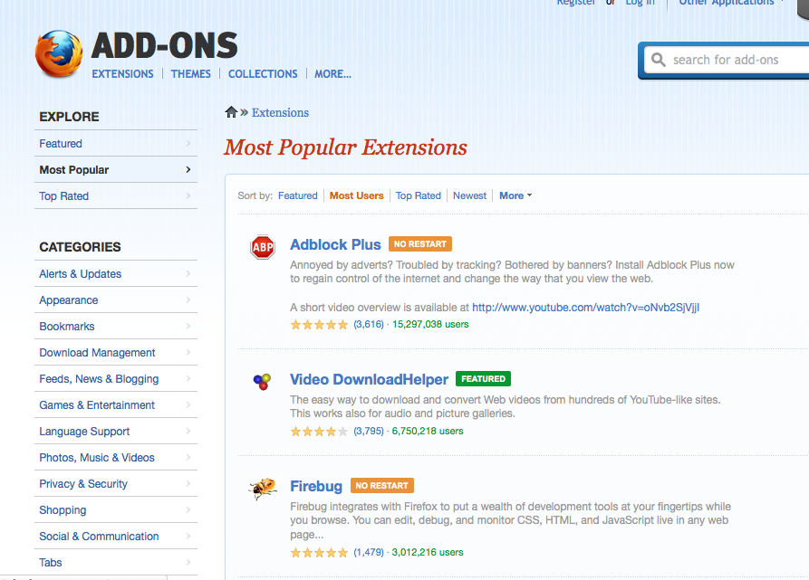
Extensions
Extensions Vs. Plugins
Plugins are complicated, loadable modules. Flash and Java are two examples
Extensions are written mostly in JavaScript. They act as part of the browser and they have wider access privileges than JS-in-a-webpage
150 million extensions are in use
Notes:
Browser extensions are remarkably popular, with one in
three Firefox users running at least one extension, well-intentioned, extension developers are often not security
experts and write buggy code that can be exploited by ma-
licious web site operators.
Browser extensions expand the functionality of browsers by interacting with browser-level events and data
Easy to write

Slide 4
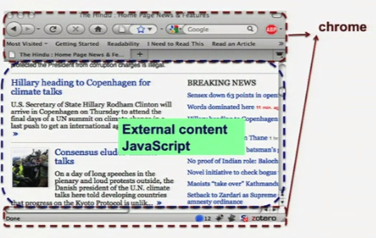
Extensions architecture in firefox
Notes:
Extension can access local files, networks and all web pages
Page privileges are more restrictive than chrome privileges. A page loaded from site x can’t access content from sites other than x

Slide 5
Extensions are not secure
Developers:
Many developers write extensions because of hobbies
Likely to write vulnerable extensions
Don’t have time or interests to update their extensions
Reviewers:
Not possible to understand all the extensions
Don’t need to have great knowledge about extensions or security
Follow guidelines for what is not acceptable:
The guidelines focus on finding malicious extensions
Vulnerable extensions can quiet easily slip through.

Slide 6
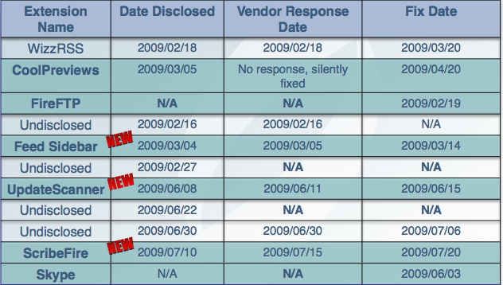
Examples
Real Extension Vulnerabilities
by Roberto Suggi Liverani and Nick Freeman
http://www.securitytube.net/video/3492

Slide 7
Skype(<=3.8.0.188)
ISSUE:
Automatic arbitory

Slide 17
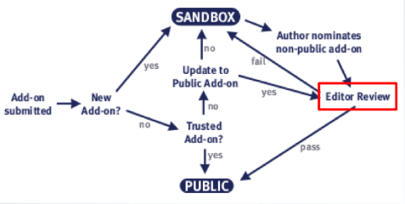
Vet Extension
Mozilla has a team of volunteers who help vet extensions manually.
Trusted add-on can’t always be trusted
Vietnamese Language Pack
Notes:
Anyone can write and upload an extension
http://blog.mozilla.org/security/2008/05/07/compromised-file-in-vietnamese-language-pack-for-firefox-2/

Slide 18
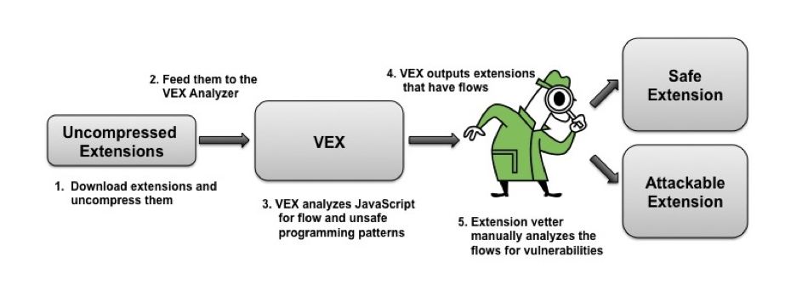
Threat Model
GOAL:
finding security vulnerabilities in browser extensions
ASSUMPTIONS:
1. Developers are not malicious
2. Extensions are not obfuscated

Slide 19
Points of attack
eval function
InnerHTML
EvalInSandBox
wrappedJSObject

Slide 20
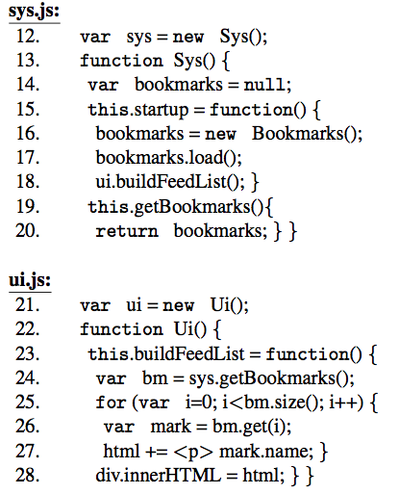
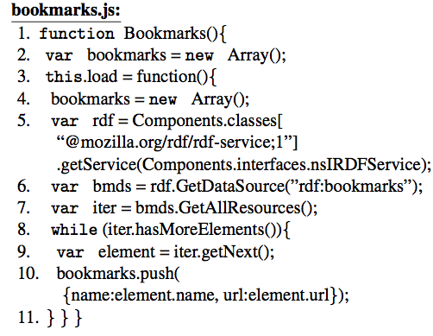
Static information flow analysis
1. Basic Goals
Find Suspicious Flow
Pattern
Source
Sink

Slide 21
Suspicious flow pattern
Resource Description Framework (RDF) data to InnerHTML
Content document data to eval
Content document data to innerHTML
evalInSandbox return objects used improperly by code running with chrome privileges
wrappedJSObject return object used improperly by code running with vulnerabilities
The five flows don’t always result in a vulnerability and they are not an exhaustive list of all possible extension security bugs.

Slide 22
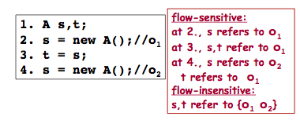
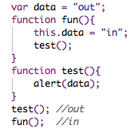
Static information flow analysis
Static Vs. Dynamic
Static: efficient and Complete
Dynamic: accurate
Context Sensitive and Flow Sensitive
Abstract Heap is Required!
Notes:
Each variable is a node, nodes are connected by their relationships.
Each node contains a dependency set, which contains all the nodes that it depend

Slide 23
Analysis Details
Variable Access
Check current scope (heap)
Check global scope (heap)
Create a new node and add it to global scope
Ignore prototype
Return with dependencies

Slide 24
Analysis Details
Binary Operators
Return the union of dependencies of both expressions
Object
Create heap locations for each of its properties
Create a node for the object
Link the object node to its property nodes

Slide 25
Analysis Details
Function
Create heap location for each of its properties
Create heap location for each of the arguments
Create heap location for return value
Create heap location for itself
A function call executes all the argument parameters and updates corresponding nodes
If a function is not defined, the dependencies of the return values are the union of dependencies of all the arguments
Does a function call execute the statements again?

Slide 26
Analysis Details
Variable Declaration
If the variable doesn’t exist in current scope, create a new node.
Otherwise, replace the current one.
Assignment
Evaluate left side expressions and right side expressions
Replace the node on the left with the one on the right

Slide 27
Analysis Details
Condition
Both IF and ELSE branches needs to be evaluated.
While
While body needs to be evaluated till reaching a fixed point

Slide 28
Analysis Details
9. EVAL
if the argument is constant string, the string will be inserted into the codes and analyzed as codes.
If the strings are not statically known, they are ignored.
VEX is unsound

Slide 29
Analysis Details
Object properties accessed in the form of associative arrays.
In JavaScript, objects are treated as associative arrays
VEX doesn’t know which property is set.
Whenever a property is created, its dependencies are added to the dependencies of the node.

Slide 30
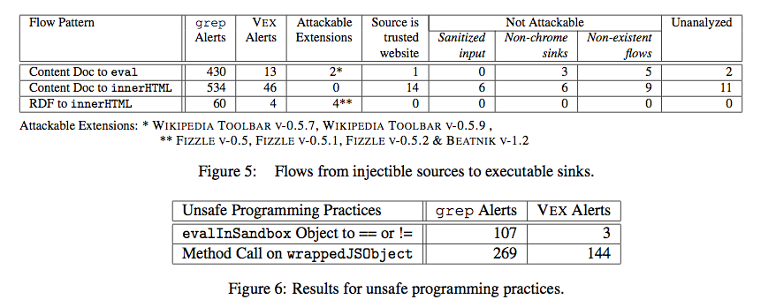
Evaluation
Download a total of 2452 extensions, on an average, VEX took only 15.5 seconds per extension

Slide 31
Successful Attacks
Wikipedia, Toolbar, up to version 0.5.9

Slide 32
Successful Attacks
Fizzle versions 0.5, 0.5.1, 0.5.2

Slide 33
Successful Attacks
Beatnik Version 1.2

Slide 34
Flows that do not result in attacks
Source is trusted (what about XSS?)
Sanitized input (Complete?)
Non-chrome sinks (less privileges)

Slide 35
Related Works
Plugin security
Dynamic information flow analysis for browser extensions
Flow-insensitive static information flow methods for JavaScript

